Slide 1
CUBA’S AGRICULTURAL SECTOR AND FOOD TRADE: IMPLICATIONS FOR FLORIDA AGRICULTURE
Presentation to the
Florida Agriculture Financial Management Conference
Orlando, Florida, August 27th, 2015
by William A. Messina, Jr., UF/IFAS
Food and Resource Economics Department

Slide 2
OUR ROLE . . . ANALYSTS, NOT ADVOCATES
WE DO NOT MAKE RECOMMENDATIONS REGARDING THE U.S. EMBARGO!
We simply try to provide current data, information and objective analyses on Cuba’s agricultural sector to all interested parties
  Florida and U.S. agriculture, USDA, State Department, USITC, Commerce Department, Congressional Committees, the Congressional Research Service, etc.

Slide 3
REGARDING PRESIDENT OBAMA’S DECEMBER ANNOUNCEMENT . . .
The President of the United States CAN resume DIPLOMATIC relations with Cuba under Executive Order.
The Embargo is Law (Helms Burton from 1996) so it will require House, Senate and Presidential approval to be lifted.
We are a long way from that (but be forewarned about economists making political predictions!)
Pushing the envelope . . .

Slide 4
AN ECONOMIST’S APPROACH TO ANALYZING CUBAN AGRICULTURE
TRADITIONAL FACTORS OF PRODUCTION:
  Land (and related natural resource endowments)
  Labor (human capital)
  Capital
NEW FACTORS OF PRODUCTION?
  Technology???
  Entrepreneurship

Slide 5
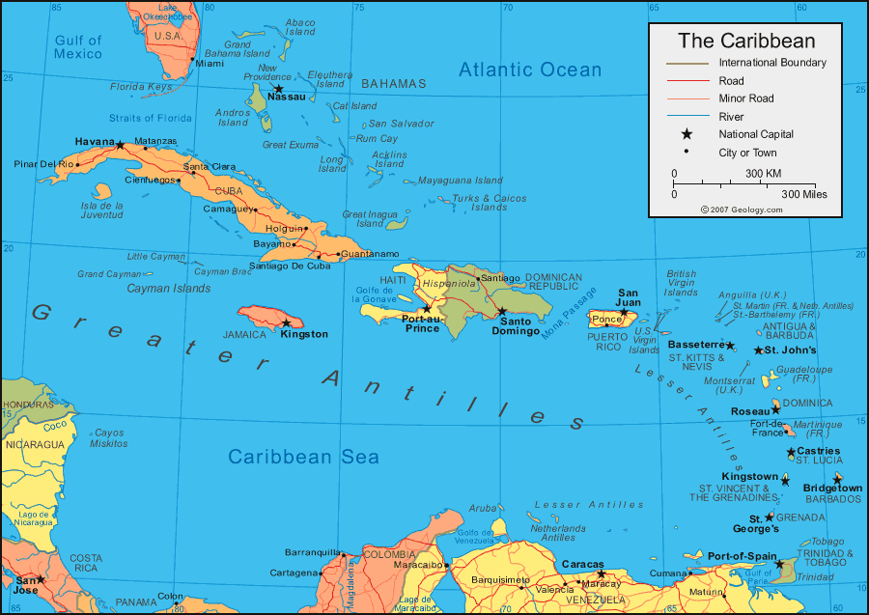
LAND - Cuba is NOT just another small Caribbean island
105,000 sq. km. (~40,500 sq. mi.) or
about ¾ the size of Florida
Very nearly as large as all of the rest of the Caribbean islands added together

Slide 6
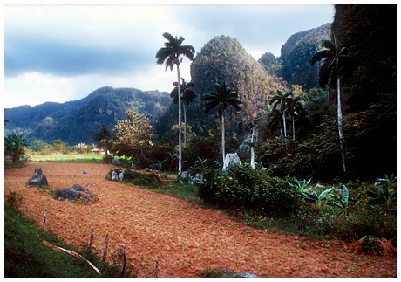
LAND - Cuba is NOT just another coral Caribbean island
Good soils
70%+ of land is arable
Some water issues
Rainfall

Slide 7
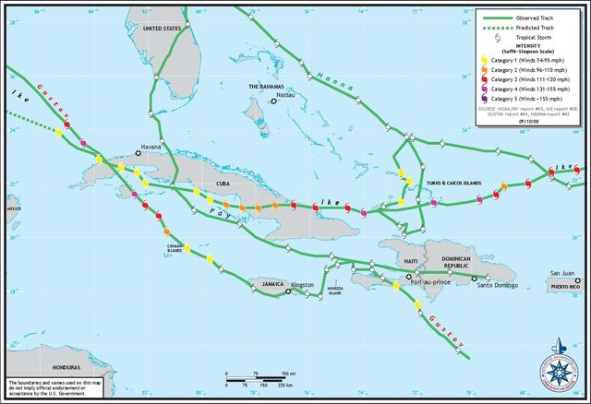
MILD WINTER CLIMATE, but HURRICANES!
  2008 Hurricane Season
  T.S. Fay: 8/16 – 8/18
  H. Gustav: 8/30 - 9/1
  H. Hanna: 9/2 – 9/3
  H. Ike: 9/8 – 9/9
  T.S. Paloma: 11/8 – 11/9

Slide 8
LABOR
Impressive, universal education system
Some labor shortages experienced in agriculture, but this is gradually changing as agriculture becomes more lucrative
 | LITERACY RATE
CUBA | 99.8%
UNITED STATES | 99%
SOURCE: CIA World Factbook

Slide 9
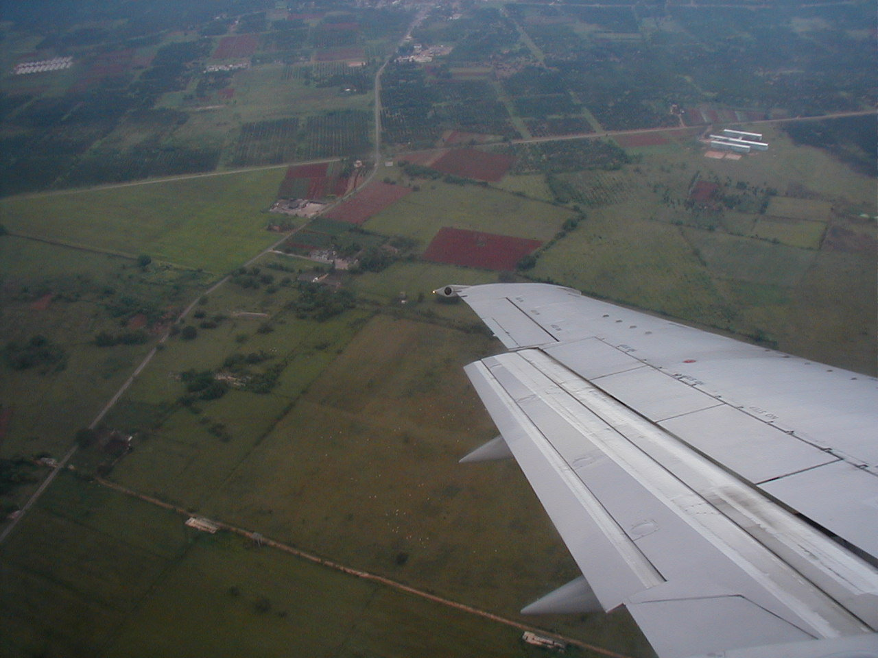
Cuba’s Rich Agricultural Tradition is Apparent as You Fly into Havana

Slide 10
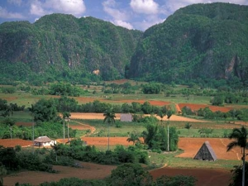
PINAR DEL RIO - WESTERN CUBA
Rounded limestone mountains called “mogotes”

Slide 11
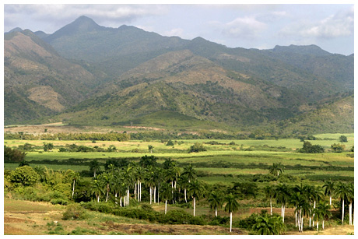
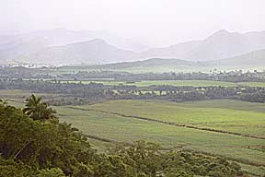
EASTERN CUBA
(SIERRA MAESTRA MTNS
IN THE BACKGROUND)
Pico Turquino rises to 6,650 ft.

Slide 12
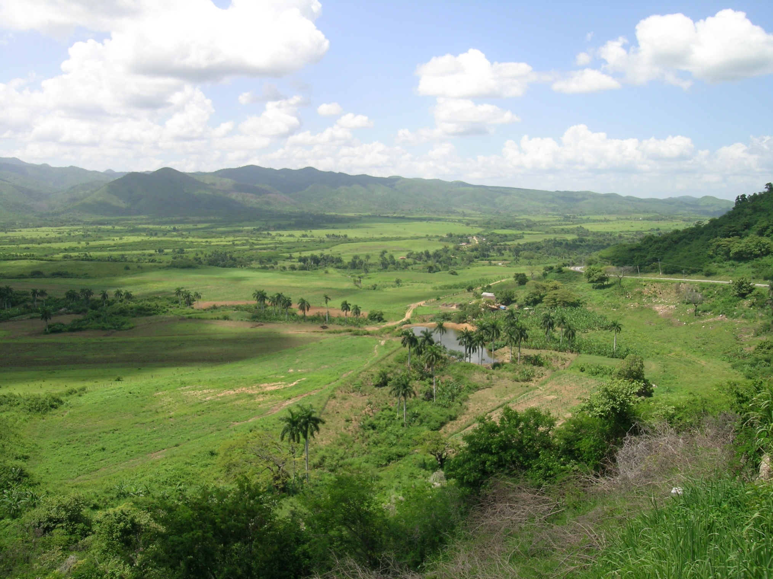
“VALLEY OF THE SUGAR MILLS”
IN CENTRAL CUBA
SO CUBA IS AN AGRICULTURAL POWERHOUSE, RIGHT?

Slide 13
NO, NOT REALLY . . .
The Cuban government reports that they have to import over 80% of their total food requirements!
  University of Havana economists estimate the figure is closer to 60%
Over $2 BILLION per year in expenditures for imported food purchases
This creates a real CHALLENGE for the Cuban government given its balance of trade and payments deficits.
How did Cuba get to this point?

Slide 14
FACTORS CONTRIBUTING TO THE HIGH LEVEL OF RELIANCE ON FOOD IMPORTS
Disproportionately heavy emphasis on sugar production for export for most of the last 200 years!
The inefficiencies inherent in the strong system of central planning, WITH NO ACCOUNTABILITY!
Since 1989/90 (fall of Berlin Wall and collapse of the Soviet Union), a lack of internal CAPITAL to commit to agriculture (or most anything else).

Slide 15
THE ISSUE OF CAPITAL
With very limited sources of internal capital, Cuba has to rely on foreign investment.
Foreign investment in agriculture has largely been limited to export crops because of very limited “effective” domestic demand.
  Citrus
  Shellfish
  Rum
  Cigars
  Greenhouse vegetables
  Sugar (recent)

Slide 16
CUBAN NON-SUGAR AGRICULTURAL PRODUCTION 2000 to 2014
Metric tons
Source: Cuban Anuario Estadistico

Slide 17
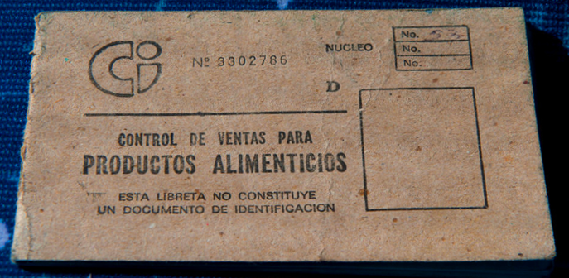

CUBA’S FOOD RATION SYSTEM

Slide 18
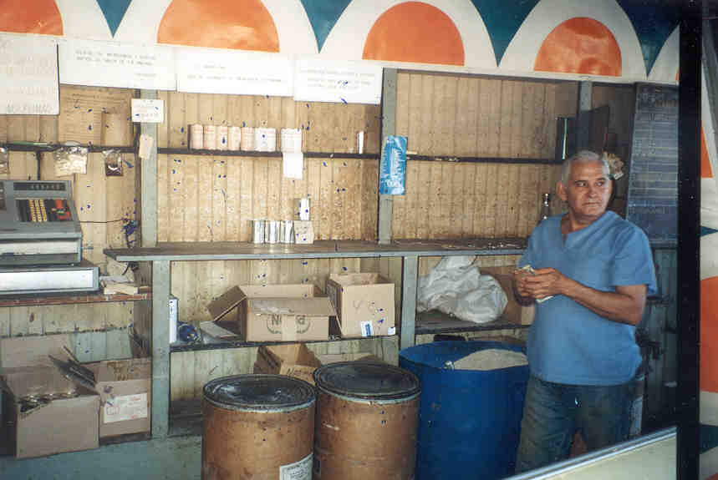
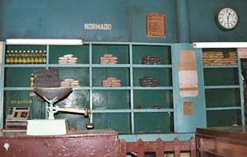
CUBA’S FOOD
RATION STORES

Slide 19
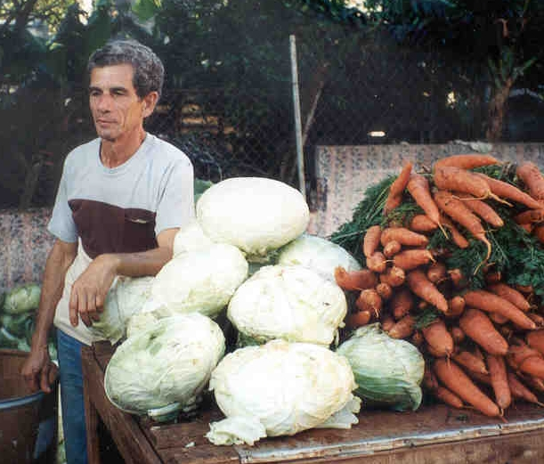
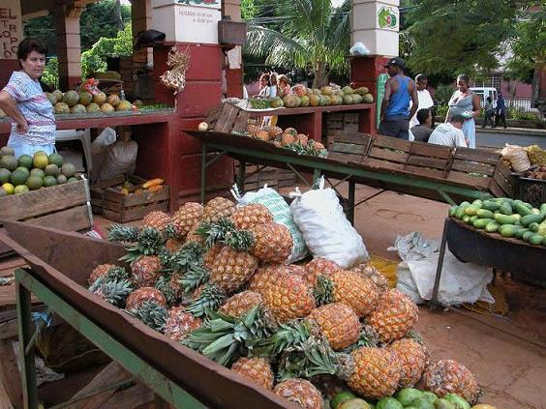
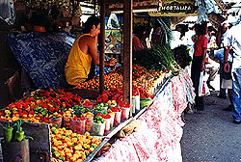
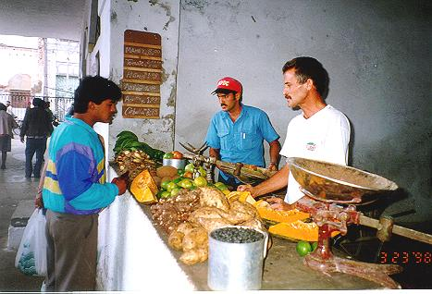
CUBA’S AGRICULTURAL MARKETS
Entrepreneurship!

Slide 20
THE CUBAN GOVERNMENT RECOGNIZES THAT INCENTIVES WORK!
Without incentives

Slide 21
THE CUBAN GOVERNMENT RECOGNIZES THAT INCENTIVES WORK!
Without incentives
With incentives

Slide 22
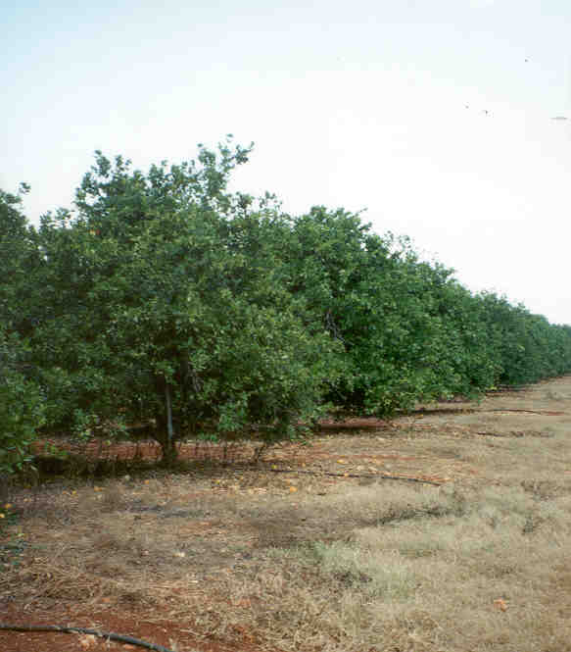
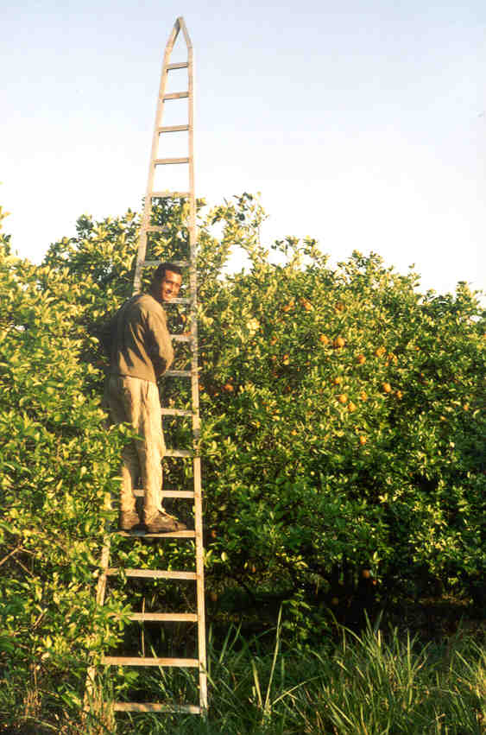
CITRUS – 2008

Slide 23
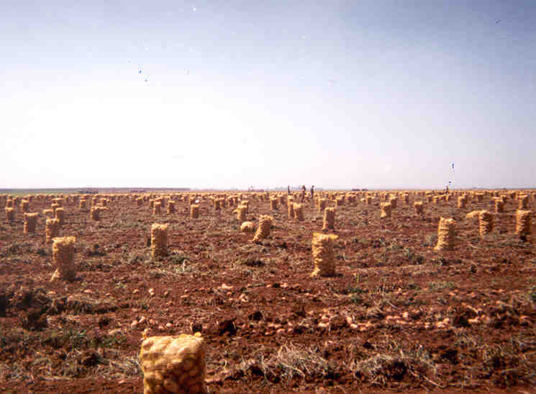
VEGETABLES

Slide 24
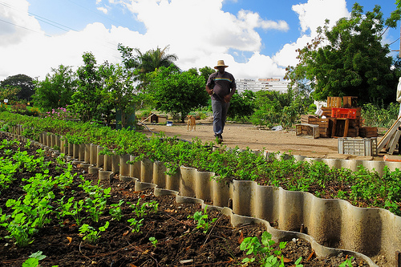
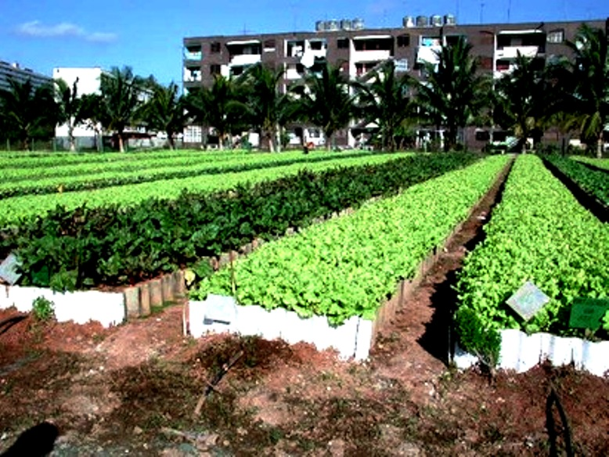
VEGETABLES
(urban gardens)

Slide 25
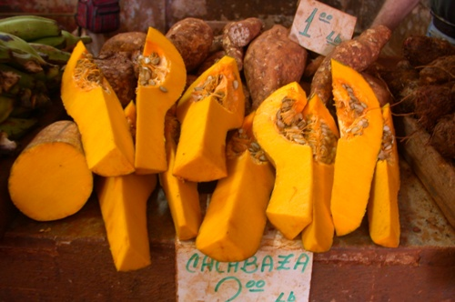
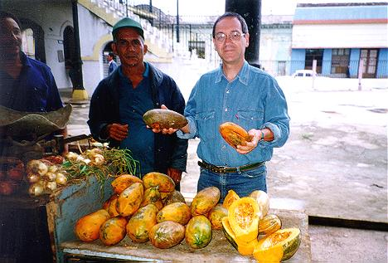
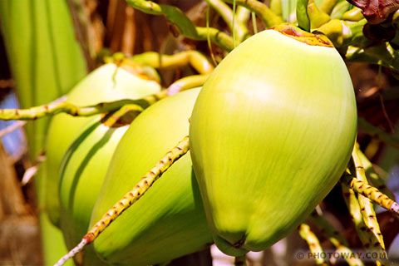
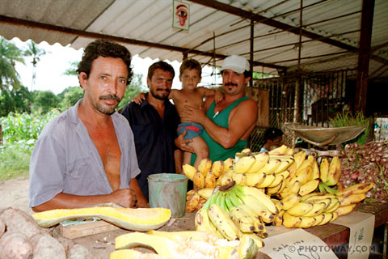
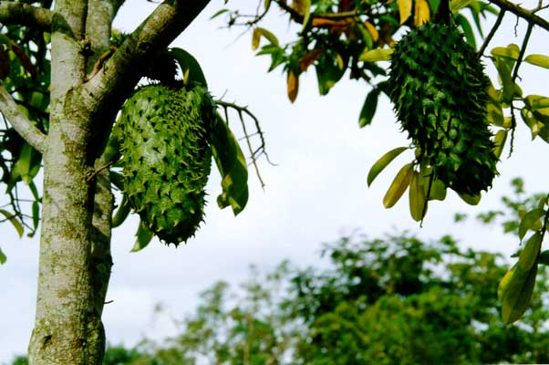
TROPICAL FRUIT

Slide 26
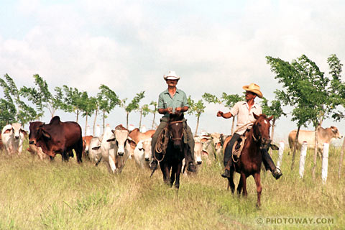
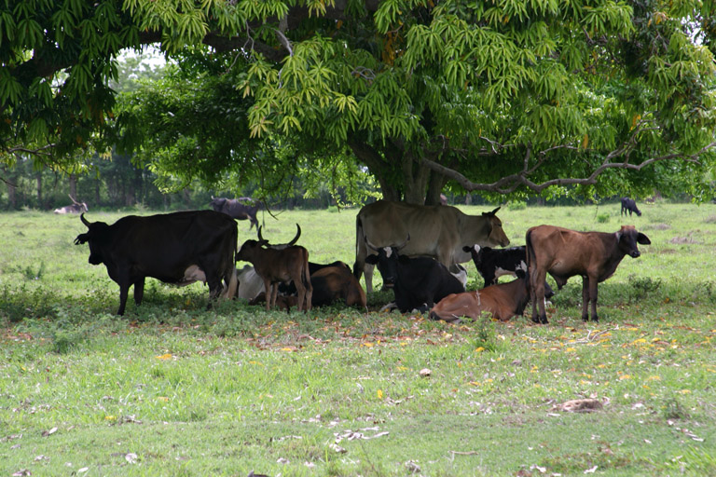
LIVESTOCK
AND CATTLE RANCHING

Slide 27
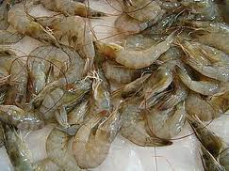
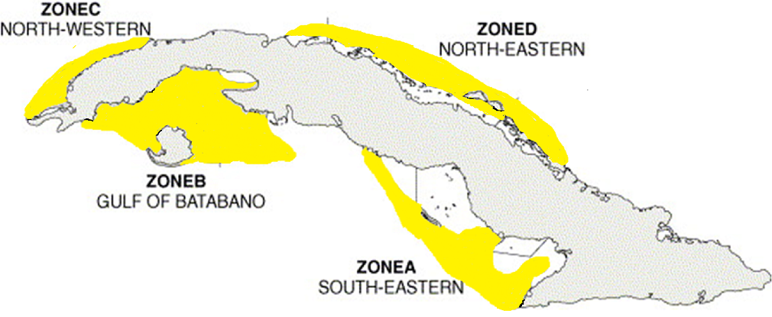
MARINE FISHERIES
Map of Cuban Spiny Lobster and Shrimp Production Areas

Slide 28
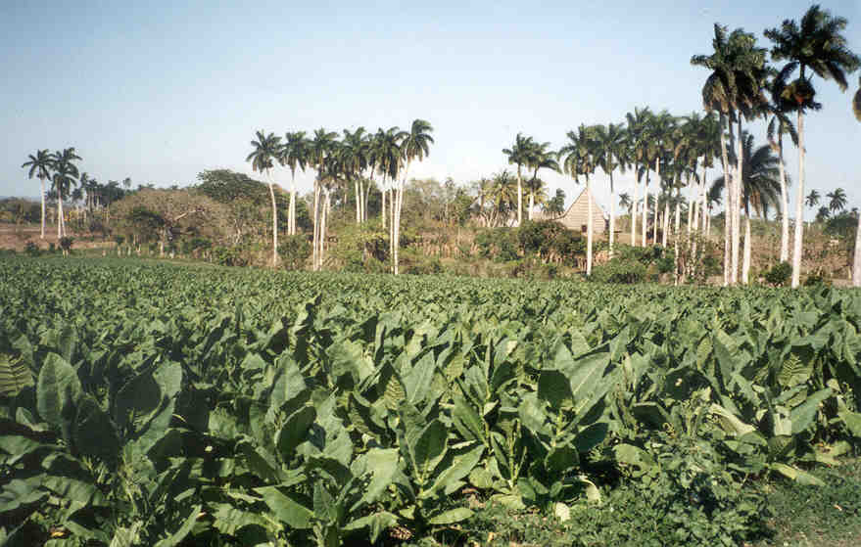
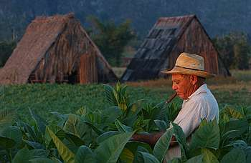
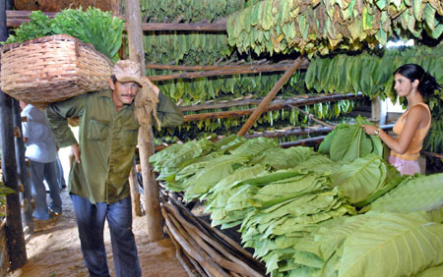
TOBACCO

Slide 29
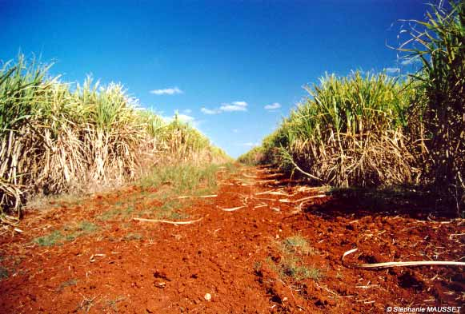
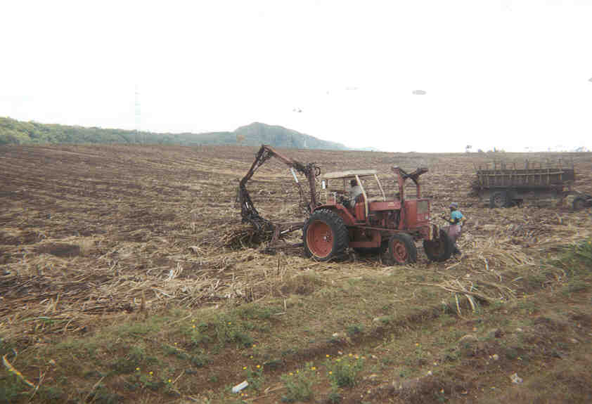
SUGAR

Slide 30
CUBA’S AGRICULTURAL PRODUCTION PATTERNS AND FLORIDA’S ARE VERY SIMILAR!
Sugar
Citrus
Vegetables
Tropical Fruit
Livestock and Ranching
Marine and Seafood Products
For Florida, nursery and landscape, turf, strawberries, forestry etc. also are important.

Slide 31
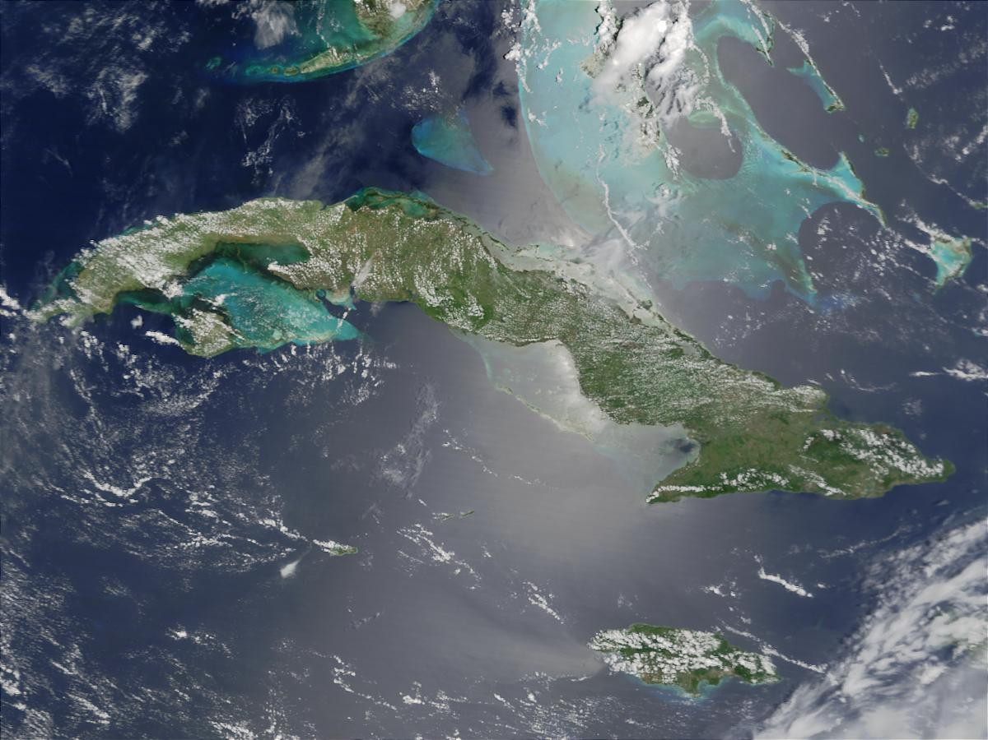

SIMILAR CROPS AND PRODUCTION SEASONS
= 90 MILES
Resumption of trade between the U.S. and Cuba, whenever it occurs, will have a more significant impact on Florida agriculture than any single event in the history of our state! = Potential Challenges and Opportunities
.

Slide 32
POST-EMBARGO – POTENTIAL CHALLENGES
Concerns expressed in Florida about resumption of trade and commercial relations with Cuba include:
Potential import of invasive pests and diseases
  Estimates are that invasive pests have caused over $120 BILLION in damages to U.S. agriculture
  Florida is the gateway for many invasive pests and diseases into the United States
Potential subsidized competition

Slide 33
POST-EMBARGO – POTENTIAL OPPORTUNITIES
Some growers and agribusiness firms in Florida (and elsewhere in the United States) are looking into possible joint venture business opportunities in Cuba.
And what about firms from other countries?

Slide 34
OVERSEAS COMPETITION
More than 4,500 firms from over 100 countries are presently doing business in Cuba, and they LOVE OPERATING WITHOUT U.S. COMPETITION!
“Those who get in early are likely to fare better and have better relations with locals, which is key to establishing a long-term presence.”
    Ed Daly of iJET International, which provides risk management for businesses operating internationally.

Slide 35
CUBA’S FOREIGN INVESTMENT NEEDS
Cuba needs to attract $2 billion to $2.5 billion in foreign direct investment per year to reach its economic growth target of 5 to 7 percent . . .
      Rodrigo Malmierca, Cuba’s Minister for Foreign Trade and Investment
      March 2014
List of 246 projects announced at Mariel Special Development Zone that would require $8.7 billion in investment (from farms to a light auto plant)

Slide 36
$2 to $2.5 BILLION IN F.D.I. – A VERY AMBITIOUS TARGET!
Cuba’s laws for FDI are still evolving.
The issue of expropriated U.S. properties remains unresolved (7,028 certified claims totaling over $5 billion with interest).
Cuba’s recent track record is spotty, though some successes in resort hotels & nickel.
Command and control bureaucracy is cumbersome, which slows decision making.
China example – Proposed $1 million plant to assemble LED bulbs and employ 100 Cubans – 3 mo. + 3 mo. + ??? mo.
  “In China this would take 24 hours!”

Slide 37
CREDIT WORTHINESS?
Cuba is consistently ranked among the world’s worst credit risks by Euromonitor.
Paris Club debt (to governments) officially just over $35 billion.
Cuba owes commercial creditors perhaps another $20 billion of principal and interest from before and after it declared default in the late 1980s.
How did Cuba deal with its old Soviet debt?
Cuba has restructured its debt with China, Japan, Mexico and Russia, each time obtaining substantial reductions in what it owed.
Limited security for loans/investment

Slide 38
FROM THE U.S. SMALL BUSINESS ADMINISTRATION
“We are convinced that the best way to ensure opportunity and democracy in Cuba is by empowering the Cuban people – rather than denying them access to resources. At the same time, American businesses, small and large, stand to gain access to an important new market for goods and services only 90 miles from our shores. While there remains much work to be done, this is an important start. We at the SBA stand ready to work with American small businesses to realize the full potential of today’s historic announcement.”
SBA Administrator Maria Contreras-Sweet
    December 17, 2014

Slide 39
CUBAN SUGAR PRODUCTION – 1989/90, 2010/11 & 2014/15 SEASONS
 | 1989/90 | 2010/11 | 2014/15
 | MILLION metric tons
PRODUCTION | 8.4
In the late 1980s, Cuba was the world’s third largest sugar producer (behind Brazil and India), and the world’s largest sugar exporter

Slide 40
SUGAR EXPORTS – DRIVING THE CUBAN ECONOMY
In the late 1980s, Cuba exported almost 8 million metric tons of sugar per year, at 30+ cents/lb. to the former Soviet Union and Eastern Europe.
Sugar exports generated about 80% of Cuba’s total export revenue.
Plus Cuba was importing petroleum products and other goods from the Soviets at preferential prices.
Preferential markets lost almost overnight with fall of the Berlin Wall and the dissolution of the Soviet Union!

Slide 41
CUBAN SUGAR PRODUCTION – 1989/90, 2010/11 & 2014/15 SEASONS
 | 1989/90 | 2010/11 | 2014/15
 | MILLION metric tons
PRODUCTION | 8.4 | 1.1
Cuba’s sugar production in the 2010/11 season was the worst in a century!
Cuba consumes about 700,000 tons domestically

Slide 42
BRAZIL IS A POTENTIAL “GAME-CHANGER” FOR CUBA
Brazil provided $680 million in financing to refurbish and expand Cuba’s Port at Mariel
$400 million in credits for food purchases
  Brazil was Cuba’s largest food supplier in 2011 and again in 2014
$200 million to “improve agriculture”
Invested in Cuba’s poultry industry
Assisting with soybean production
AND if there is any question about Brazil’s level of interest in Cuba . . .

Slide 43
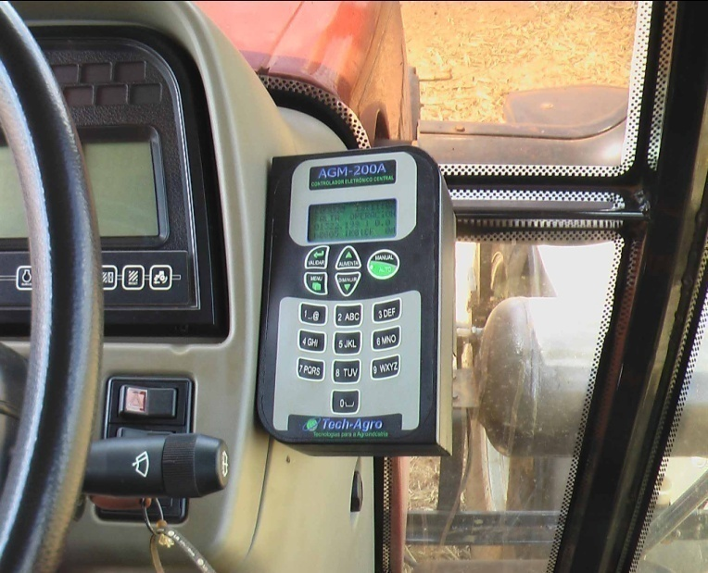
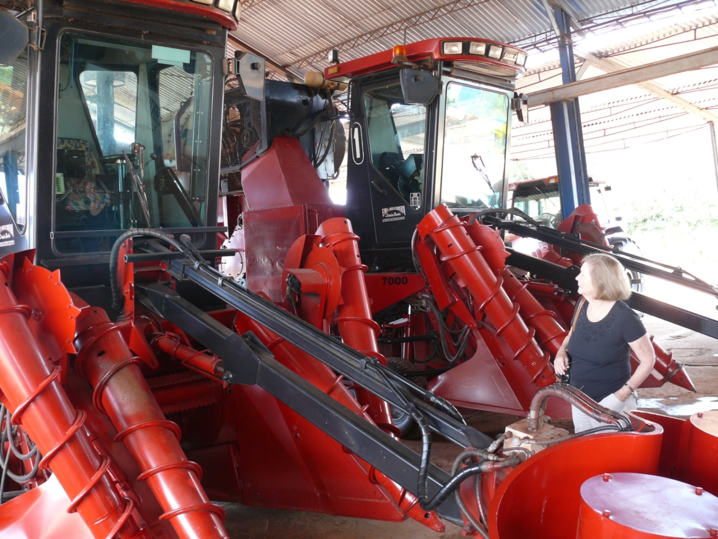
BRAZILIAN EQUIPMENT IN CUBA, October 2011

Slide 44
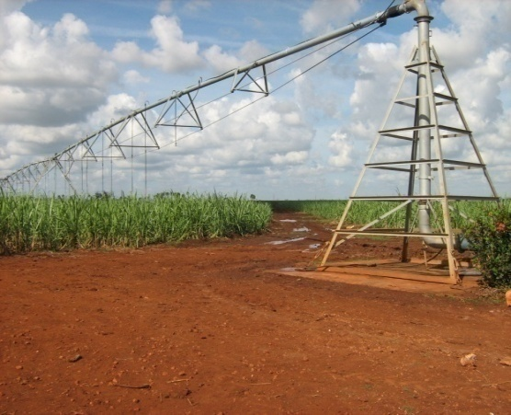
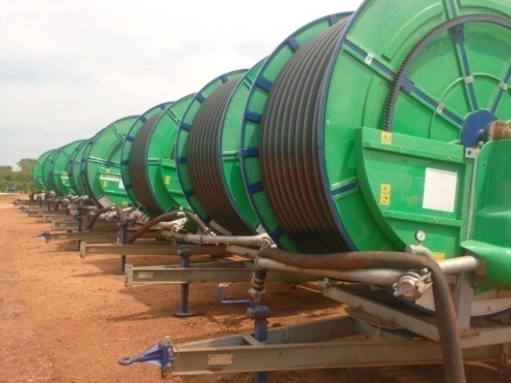
BRAZILIAN EQUIPMENT IN CUBA, October 2011

Slide 45
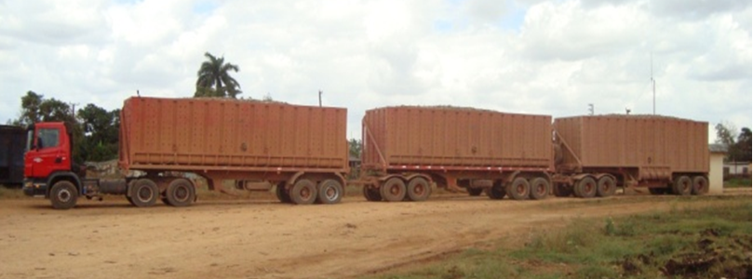
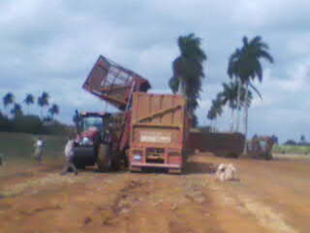
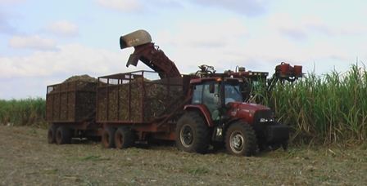
BRAZILIAN EQUIPMENT IN CUBA, October 2011

Slide 46
BRAZILIAN EQUIPMENT IN CUBA, October 2011
Brazil is also investing in refurbishing a Cuban sugar mill and managing its operation

Slide 47
CUBAN SUGAR PRODUCTION – 1989/90, 2010/11 & 2014/15 SEASONS
 | 1989/90 | 2010/11 | 2014/15
 | MILLION metric tons
PRODUCTION | 8.4 | 1.1 | 1.8
After 2010/11, sugar production increased by more than 60% in only 4 seasons!
Result of Brazilian investment

Slide 48
BRAZIL’S AGRICULTURAL INVESTMENT, THOUGH LIMITED, HAS HAD AN IMPACT
60% increase in sugar output in the past four seasons is significant!
Sugar is the only agricultural commodity sector in Cuba experiencing significant growth.
Cuba’s experience in sugar demonstrates how foreign investment has the potential to dramatically change its agricultural sector!
This experience could presumably be replicated for other crops and commodities.

Slide 49
BRAZIL IS BECOMING AN INCREASINGLY IMPORTANT PLAYER IN CUBA
“Socialist governments traditionally do make a financial mess. They always run out of other people’s money.”
former British Prime Minister
Margaret Thatcher
  Cuba ran out of the Soviet Union’s money . . .
  May be running out of Venezuela’s money . . .
  Next Brazil???

Slide 50
TRADE SANCTIONS REFORM AND EXPORT ENHANCEMENT ACT
The Trade Sanctions Reform and Export Enhancement Act (TSRA) of 2000 allows U.S. firms to sell agricultural products (and medicine) to Cuba.
  Cash sales only
  One way trade only
U.S. agriculture has shipped over $5 BILLION of food and agricultural exports to Cuba since passage of TSRA

Slide 51
CUBA FOOD AND AG PURCHASES FROM THE UNITED STATES (>$5B)
2014 sales were the lowest 11 yrs!
$ Million
Source: USDA Global Agricultural Trade System data

Slide 52
CUBAN FOOD AND AG. IMPORTS
BY COUNTRY, 2000 - 2014
Since 2002 the U.S has been Cuba’s #1 supplier of imported food & agricultural products in all but 2 years (2011, 2014)!
$ Million
Source: GTIS

Slide 53
U.S. STRENGTHS & WEAKNESSES
U.S. strengths as an ag. and food supplier:
  Geographic proximity
    lower transportation costs
    faster delivery (particularly important for highly perishable, high value commodities)
    allows for lower economic order quantities
  Reliable supplier of high quality products
U.S. weaknesses as an ag. and food supplier:
  Cash sale requirements
  Transactions must go through third-country banks
  U.S. policy can be erratic

Slide 54
HOW DOES THE RECENT ANNOUNCEMENT AFFECT U.S. STRENGTHS AND WEAKNESSES?
U.S. strengths as a supplier:
  Geographic proximity – No change
  High quality supplier – No change
U.S. weaknesses as a supplier:
  Cash sale requirements – Minor change
  Transactions must go through third-country banks – Soon to change (minor factor)
  U.S. policy can be erratic – No change

Slide 55
HOW MIGHT THE RECENT ANNOUNCEMENT AFFECT U.S. FOOD AND AG EXPORTS TO CUBA?
President’s announcement does not materially change the terms & conditions for U.S. food and agricultural product sales to Cuba.
So expect no significant increase in U.S. exports
U.S. sales to Cuba for the first six months of 2015 have decreased by more than 40% from the same period last year.
Prospects for 2015 look poor, unless Cuba sees some political benefit to increasing purchases from the U.S.

Slide 56
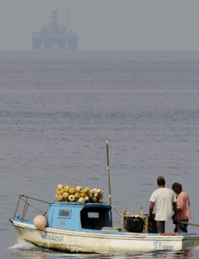
ANOTHER POTENTIAL GAME CHANGER – OIL!
Photo by:
Javier Galeano Associated Press
January 19, 2012

Slide 57
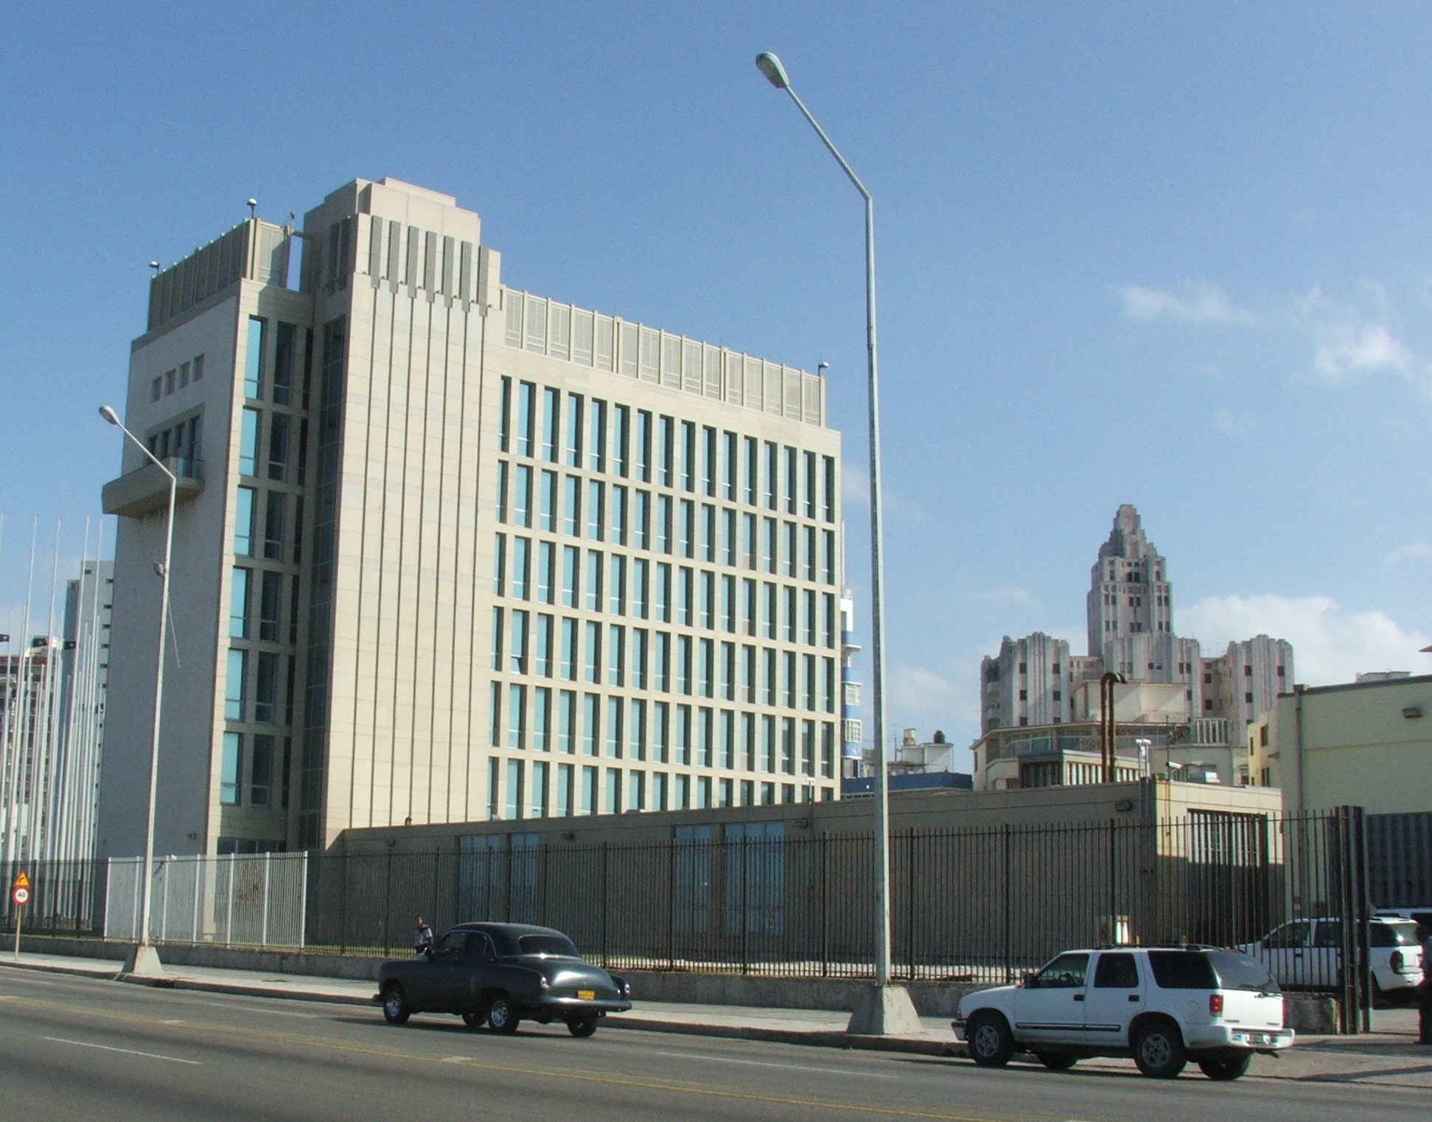
U.S. INTERESTS SECTION – NOW THE U.S EMBASSY
http://upload.wikimedia.org/wikipedia/commons/1/1f/US_Interest_section_Habana_4495.JPG

Slide 58
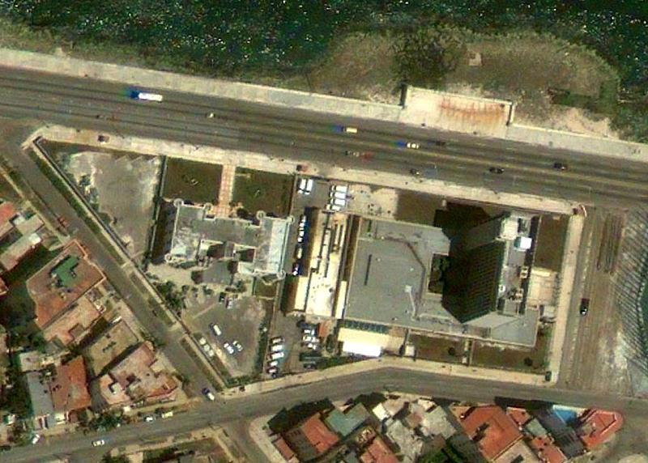
THE ULTIMATE IRONY?
For years the United States has had the largest delegation of foreign service personnel in Cuba of any country in the world!
http://cryptome.org/2015-info/us-interests-cu/pict77.jpg

Slide 59
THANK YOU!
Bill Messina
University of Florida/IFAS
Food and Resource Economics Dept.
Email: wamess@ufl.edu
Voice: 352 294-7656

